Slide 1

The Top Five Tasks IT Admins Can Automate
>_
#!
Presented by:
Adam the Automator and IpSwitch

Slide 2
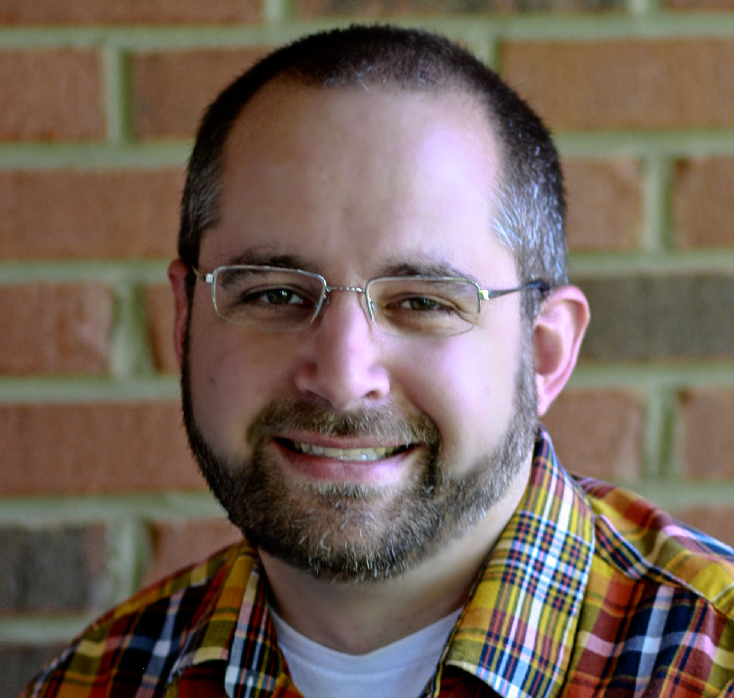
Your Guide
Senior Automation Engineer
Pluralsight Author
PowerShell Trainer
Freelance Writer
adamtheautomator.com
Twitter: @adbertram
Microsoft Content/ Datacenter Management MVP

Slide 3
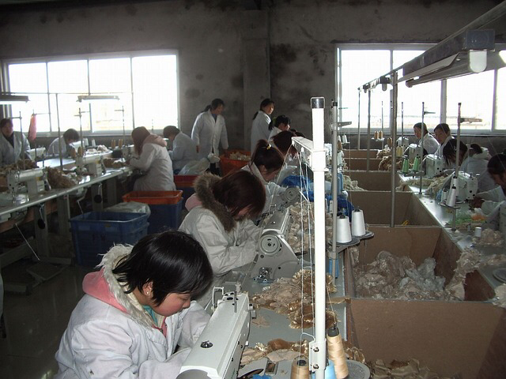
Automate the Boring Stuff
Mundane tasks
Routine work
…but necessary

Slide 4
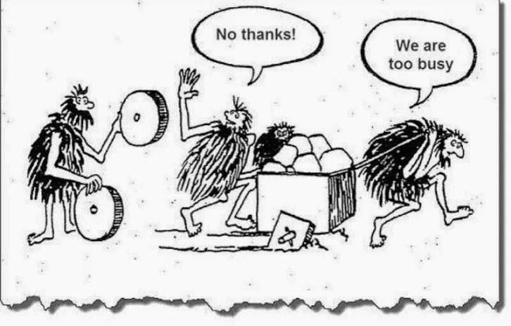
We Don't Have Time to Automate!

Slide 5
PowerShell is an IT Admin's Best Friend
Ubiquitous
IT-friendly (developers not necessary)
Can automate anything
PowerShell is automation glue

Slide 6
Demos: Five Common IT Automation Tasks
Keeping Active Directory healthy
Automating new employee provisioning
Exporting Azure SQL data into a CSV
Automating physical to virtual conversions
SLA reporting with MoveIt

Slide 7
Resources
PowerShell Scripts
http://bit.ly/moveit_powershell
Review setup_instructions.txt

